Slide 1
OBSERVATION TRAINING
CROWDSOURCE: SCIENCE
Science Education For Elementary
Students With Learning Disabilities
This material is based up on work supported by the National Science Foundation under Grant No. 2201464. Any opinions, findings, and conclusions or recommendations expressed in this material are those of the authors and do not necessarily reflect the view of the National Science Foundation.

Slide 2
OBSERVATION TRAINING
CROWDSOURCE: SCIENCE
TABLE OF CONTENTS
Science Content And Instruction
Observation Grid
Opportunities To Respond (OTR) Codes
Teacher Feedback Codes
Target Student Codes
Overall Quality of Science Instruction
Observation Procedures
Coding Practice: Transcripts:
Lesson Transcript Example A
Lesson Transcript Example B
Lesson Transcript Example C
Coding Practice: Videos:
Lesson Video Example #1

Slide 3
OBSERVATION TRAINING
CROWDSOURCE: SCIENCE
AGENDA
Science Content & Instruction Section
Observation Grid
Opportunities to Respond (OTR) Codes
Teacher Feedback Codes
Target Student Codes
Overall Quality of Science Instruction Ratings
Observation Procedures
Practice!

Slide 4
OBSERVATION TRAINING
CROWDSOURCE: SCIENCE
SCIENCE CONTENT & INSTRUCTION

Slide 5
HEADING
HINTS:
IDs are located on your Observation Tracker
Target Student is indicated on your Observation Tracker
# students indicated may differ across observation rounds
Interobserver agreement (IOA) ID = Observer ID of the other observer

Slide 6
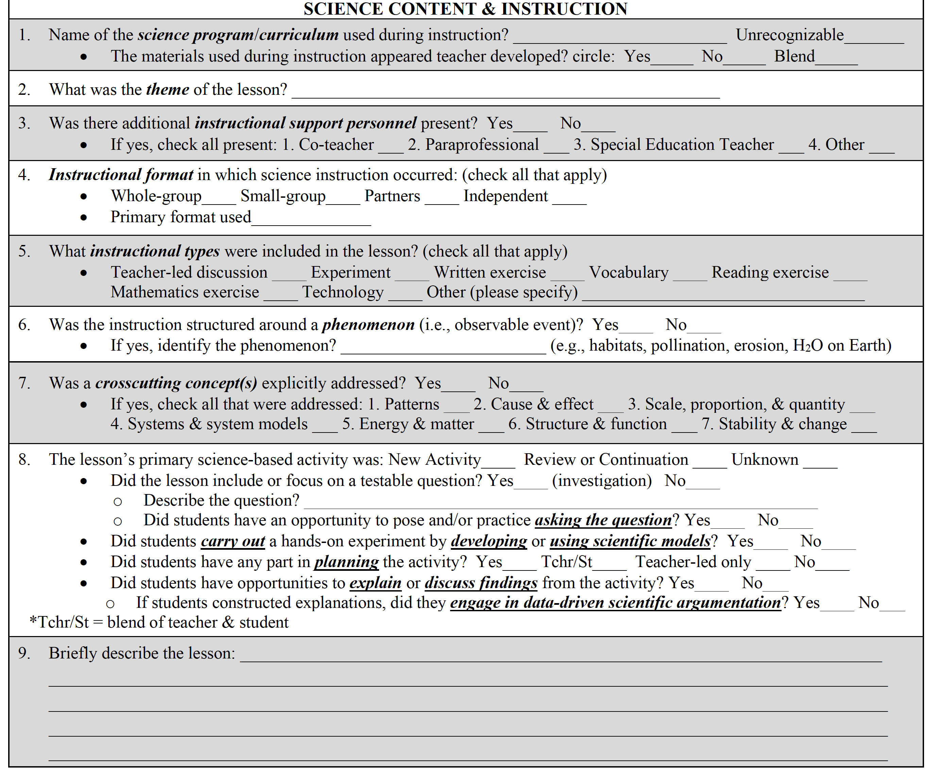
SCIENCE CONTENT & INSTRUCTION

Slide 7
Science Content & Instruction
SCIENCE PROGRAM/CURRICULUM
The science program/curriculum provides the teacher with a structure of what is intended to be taught or learned during the science lesson.
Examples of common science program/curriculum:
Amplify Science
The Classical Science Series
The Sassafras Science Series
FOSS Next Generation

Slide 8
Science Content & Instruction
THEME
The theme identifies the primary subject of the science lesson, which is situated in one of the three sciences (i.e., Life Science, Physical Science, Earth Science):
Examples of common themes:
Ecosystems (Life Science)
Plant structures (Life Science)
Energy (Physical Science)
Matter (Physical Science)
Erosion (Earth Science)
Biosphere (Earth Science)

Slide 9
Science Content & Instruction
INSTRUCTIONAL SUPPORT PERSONNEL
Instructional support personnel can be identified as anyone working with students to support the learning of the science lesson.
Examples of common instructional support personnel:
Co-teacher
Paraprofessional
Special Education Teacher

Slide 10
Science Content & Instruction
INSTRUCTIONAL FORMAT
The instructional format can vary throughout the science lesson and indicates the configurations of students in instructional groups.
Types of instructional formats:
Whole-group: Students working collectively as a class
Small-group: Groups of 3-5 students working together
Partners: Pairs of 2 (or sometimes 3) students working together
Independent: Students working by themselves

Slide 11
Science Content & Instruction
INSTRUCTIONAL TYPES
The instructional type indicates the methods used during instruction to teacher and support the learning of science.
Types of instruction:
Teacher-led discussion
Experiment
Written exercise
Vocabulary
Reading exercise
Mathematics exercise
Technology

Slide 12
Science Content & Instruction
PHENOMENON
A phenomenon is an event that occurs in the universe and can be observed either directly or using a scientific tool (e.g., microscope, telescope).
Examples of phenomenon:
Energy
Earthquakes
Volcanic eruptions
Gravity
Electricity

Slide 13
Science Content & Instruction
CROSSCUTTING CONCEPTS
Crosscutting concepts connect core ideas throughout science and must be made explicit by the teacher during the science lesson.
Core concepts must be made explicit by the teacher during the science lesson.
Crosscutting concepts:
Patterns
Cause & effect
Scale, proportion, & quantity
Systems & system models
Energy & matter
Structure & function
Stability & change

Slide 14
Science Content & Instruction
PRIMARY SCIENCE-BASED ACTIVITY
The primary science-based activity is closely related to theme of the lesson and supports student engagement with the content, focusing on the science and engineering practices on the Next Generation Science Standards (NGSS).

Slide 15
OBSERVATION TRAINING
CROWDSOURCE: SCIENCE
OBSERVATION GRID

Slide 16
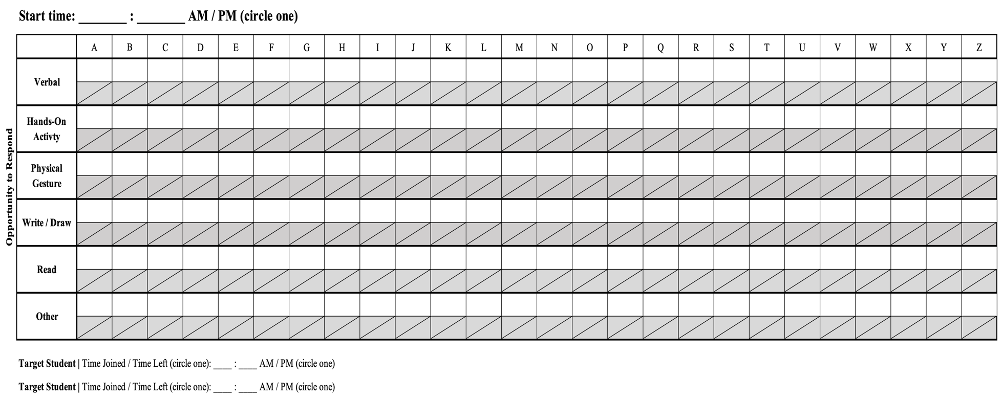
OBSERVATION GRID
PRIMARY FOCUS:
Opportunities to respond (OTR) received by non-target student(s)
OTRs received by Target Student
Teacher feedback directed at the Target Student

Slide 17
Observation Grid
GRID HEADER
Start time of the coded instruction. Note the start time for each new half-sheet.
Z = 26th code
(zz = 52nd code)

Slide 18
Observation Grid
OPPORTUNITITES TO RESPOND (OTR) CODES
OTR Code
Codes (✓) indicating OTRs received by a non-target student(s)
OTR Code
Codes (✓) indicating OTRs received by the Target Student
OTR Types

Slide 19
Observation Grid
OPPORTUNITITES TO RESPOND (OTR) CODES
Indicate the total OTRs and Teacher Feedback coded (✓) on the page, which were received by the Target Student.
Indicate the total OTRs coded (✓) on the page, which were received by non-target students.

Slide 20
Observation Grid
TEACHER FEEDBACK CODES
Teacher Feedback Code
Codes (✓) indicating academic feedback directed at the Target Student

Slide 21
Observation Grid
TARGET STUDENT CODES
Target Student Code
If applicable, indicate at what code(s) the Target Student joined and/or left the lesson by circling the column indicator(s).
Target Student Code
Indicate whether the Target Student joined and/or left during the lesson.

Slide 22
OBSERVATION TRAINING
CROWDSOURCE: SCIENCE
OPPORTUNITIES TO RESPOND (OTR) CODES

Slide 23
Opportunities to Respond (OTR) Codes
OPPORTUNITIES TO RESPOND
An opportunity to respond is an instructional strategy initiated by the teacher to provide students with opportunities to engage with instruction.
GUIDELINES:
Must be academic in nature
Must be paired with an overt student response

Slide 24
Opportunities to Respond (OTR) Codes
OPPORTUNITIES TO RESPOND
Examples of an opportunity to respond:
The teacher says, “Can anyone give me an example of erosion you’ve seen or heard of before?” A student responds, “I saw erosion at the beach when the waves washed away the sand.”
The teacher says, “Can someone please volunteer to read the paragraph on photosynthesis aloud?” A student responds and begins reading the paragraph aloud.

Slide 25
Opportunities to Respond (OTR) Codes
OPPORTUNITIES TO RESPOND
Non-examples of an opportunity to respond:
The teacher says, “Please take out your science notebooks, pencils, and the handout I gave you yesterday.” Students promptly reach into their backpacks, take out their supplies, and open their notebooks.
The teacher says, “Let’s watch this video clip to learn more about each layer of the Earth.” Students watch the video clip.

Slide 26
Opportunities to Respond (OTR) Codes
OPPORTUNITITES TO RESPOND TYPES
OTR Types

Slide 27
Opportunities to Respond (OTR) Codes
TYPES: VERBAL
Definition: an oral response from the student(s)
Examples of a verbal opportunity to respond:
Individual oral response, choral response
Teacher: | “What is the Earth’s primary source of energy?
Students: | “The Sun!”

Slide 28
Opportunities to Respond (OTR) Codes
TYPES: HANDS-ON ACTIVITY
Definition: students directly engage with materials or objects
Examples of a hands-on activity opportunity to respond:
Using a microscope, conducting an experiment
Teacher: | “Please get into your small group and start building your solar system models!”
Students: | [Break into groups and begin gathering materials.]

Slide 29
Opportunities to Respond (OTR) Codes
TYPES: PHYSICAL GESTURE
Definition: student(s) uses physical motion or movement to respond
Examples of a hands-on activity opportunity to respond:
Holding up fingers, standing up, moving to part of the room
Teacher: | “Thumbs up if you agree, the Earth orbits around the Sun!”
Students: | [Raise their thumbs.]

Slide 30
Opportunities to Respond (OTR) Codes
TYPES: WRITE/DRAW
Definition: student(s) responds through written words or illustrations
Examples of a write/draw opportunity to respond:
Writing a summary, drawing and/or coloring a diagram
Teacher: | “What is the Earth’s primary source of energy? Write your answer in your notebook.”
Students: | [Write down “sun” in their notebooks.]

Slide 31
Opportunities to Respond (OTR) Codes
TYPES: READ
Definition: student(s) responds by reading aloud
Examples of a read opportunity to respond:
Individual or choral reading
Teacher: | “Read along on the board with me, ‘The Sun is Earth’s primary source of energy.”
Students: | “The Sun is Earth’s primary source of energy.”

Slide 32
Opportunities to Respond (OTR)
OPPORTUNITITES TO RESPOND CODES
OTR Code
Codes (✓) indicating OTRs received by a non-target student(s)
OTR Code
Codes (✓) indicating OTRs received by the Target Student

Slide 33
Opportunities to Respond (OTR) Codes
RECIPIENT: TARGET STUDENT
The Target Student is noted on your Observation Tracker and should be identified before beginning your observation.
The non-target students are any of the other students in the classroom aside from the Target Student.

Slide 34
Opportunities to Respond (OTR) Codes
OPPORTUNITIES TO RESPOND
Example of an OTR received by non-target student only:
Example of an OTR received by Target Student only:

Slide 35
Opportunities to Respond (OTR) Codes
OPPORTUNITIES TO RESPOND
Example of an OTR received by all students (including Target Student):
Example of an OTR received by all students not including Target Student):

Slide 36
Opportunities to Respond (OTR) Codes
OPPORTUNITIES TO RESPOND
Example of an OTR received by all students (including Target Student):
Example of an OTR received by all students not including Target Student):
A choral response for non-target students is coded the same as an individual response from a non-target student = one check (✓)

Slide 37
OBSERVATION TRAINING
CROWDSOURCE: SCIENCE
TEACHER FEEDBACK CODES

Slide 38
Opportunities to Respond (OTR)
TEACHER FEEDBACK CODES
Teacher Feedback Code
Codes (✓) indicating academic feedback directed at the Target Student

Slide 39
Teacher Feedback Codes
TEACHER FEEDBACK
Teacher feedback can be a verbal reply, physical demonstration, or written response that provides the Target Student with specific information that goes beyond simple correctness.
GUIDELINES:
Must be directed to the Target Student (whole class feedback does not count)
Must be academic in nature

Slide 40
Teacher Feedback Codes
TEACHER FEEDBACK
Examples of teacher feedback:
The teacher is speaking directly to the Target Student and says, “Great job! That’s correct, the answer is erosion.”
The teacher is speaking directly to the Target Student and says, “No, remember what we discussed about evaporation…”
Non-examples of teacher feedback:
The teacher says, “Great job, class!”
The teacher head nods at the Target Student’s response.
The teacher asks the Target Student to sit down and pay attention.

Slide 41
Teacher Feedback Codes
TEACHER FEEDBACK
Example of teacher feedback paired with an OTR received by all students:

Slide 42
Teacher Feedback Codes
TEACHER FEEDBACK
Example of teacher feedback paired with an OTR received by Target Student only:

Slide 43
OBSERVATION TRAINING
CROWDSOURCE: SCIENCE
TARGET STUDENT
CODES

Slide 44
Opportunities to Respond (OTR)
TARGET STUDENT CODES
Target Student Code
If applicable, indicate at what code(s) the Target Student joined and/or left the lesson by circling the column indicator(s).
Target Student Code
Indicate whether the Target Student joined and/or left during the lesson.

Slide 45
Target Student Codes
TARGET STUDENT
If the Target Student joins or leaves the classroom during the lesson, this should be indicated underneath the corresponding half-sheet.
INDICATORS:
Circling whether the Target Student joined or left with the time
Circling the column letter at which the Target Student joined or left

Slide 46
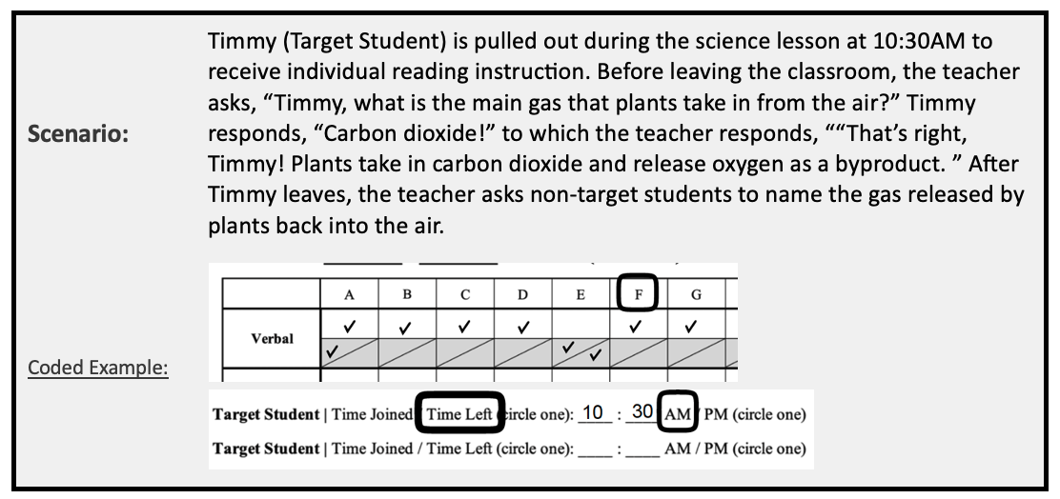
Target Student Codes
TARGET STUDENT
Example of Target Student leaving during lesson:

Slide 47
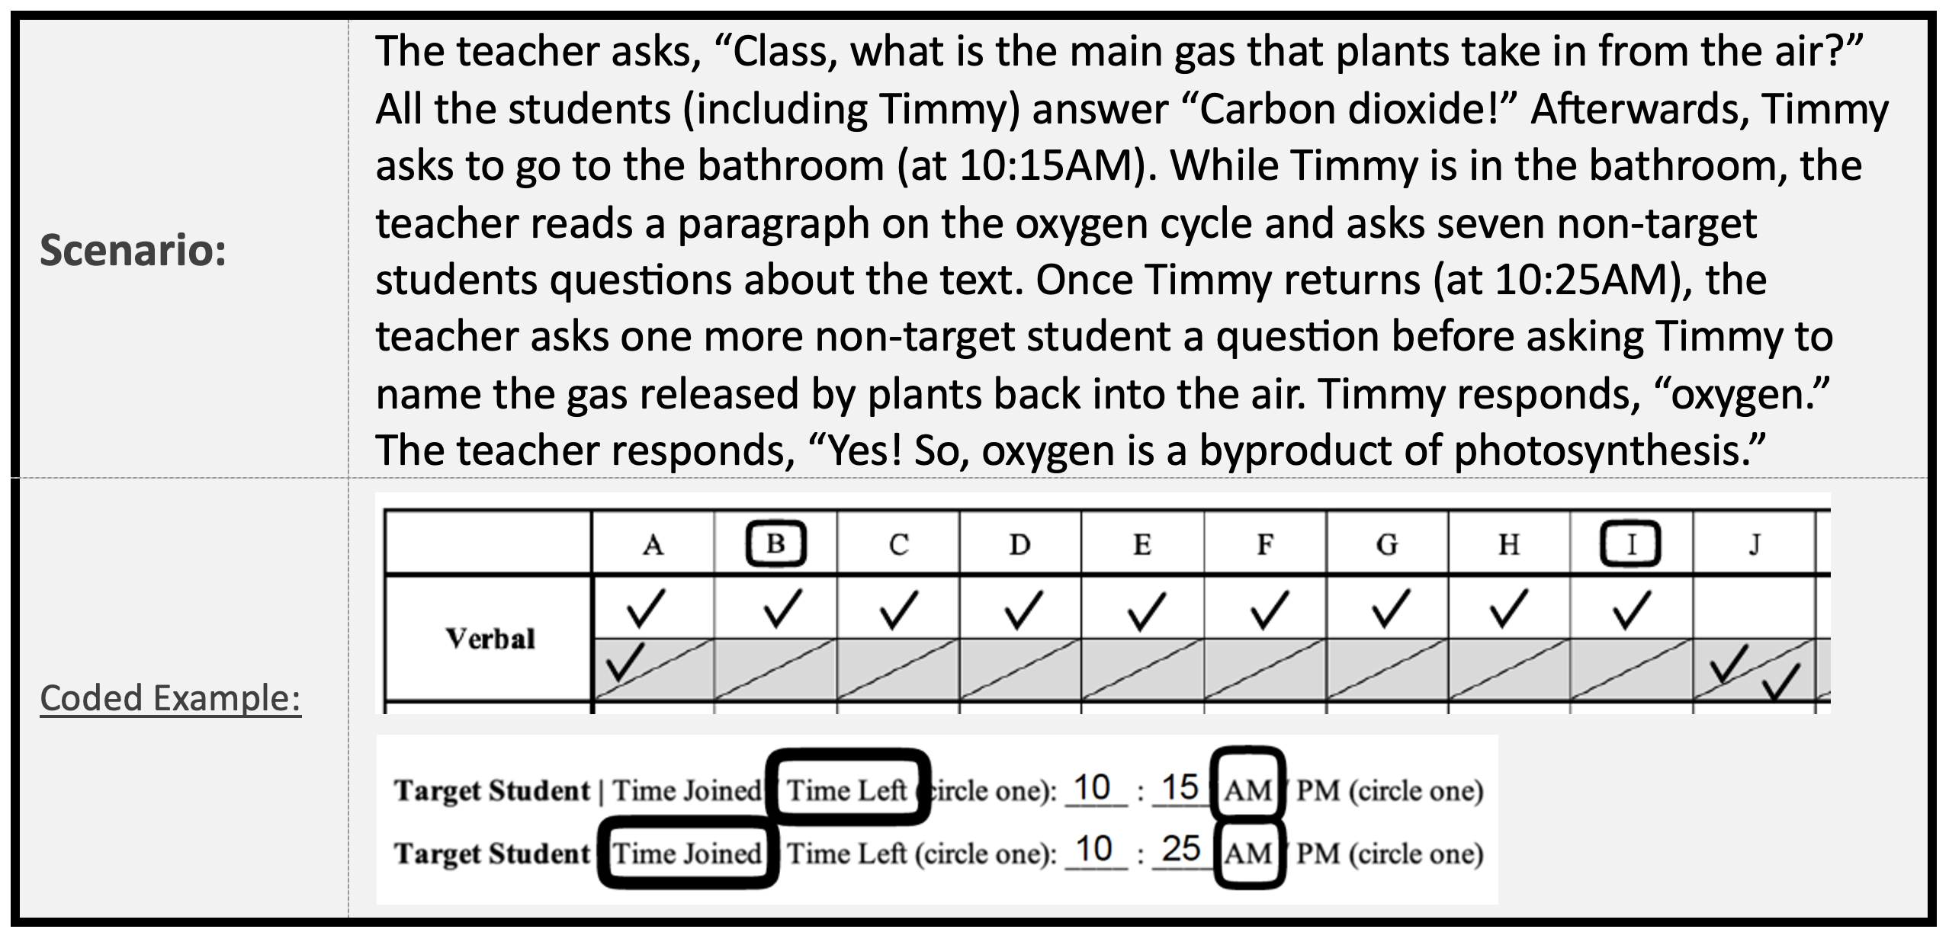
Target Student Codes
TARGET STUDENT
Example of Target Student leaving and rejoining the lesson:

Slide 48
OBSERVATION TRAINING
CROWDSOURCE: SCIENCE
OVERALL QUALITY OF SCIENCE INSTRUCTION

Slide 49
OVERALL QUALITY OF SCIENCE INSTRUCTION
PRIMARY FOCUS: Grasp the essence of the lesson observed.

Slide 50
Overall Quality of Science Instruction
Q10. OVERALL STUDENT INTEREST
OBSERVED STUDENT BEHAVIORS:
Responded to OTRs from teacher as available
Maintained eye contact with the teacher/phenomena being discussed
Minimal classroom disruptions
On-topic conversations among students as appropriate
Remained on task for most / all of the lesson
WHAT A "5" MIGHT LOOK LIKE

Slide 51
Overall Quality of Science Instruction
Q10. OVERALL STUDENT INTEREST
Q10. OVERALL STUDENT INTEREST
OVERARCHING QUESTION:
Were most students engaged for most of the lesson?
Most students were engaged:

Slide 52
Overall Quality of Science Instruction
Q11. TARGET STUDENT INTEREST
OBSERVED TARGET STUDENT BEHAVIORS:
Responded to OTRs from teacher as available
Maintained eye contact with the teacher/phenomena being discussed
Minimal classroom disruptions
On-topic conversations as appropriate
Remained on task for most / all of the lesson
WHAT A "5" MIGHT LOOK LIKE

Slide 53
Overall Quality of Science Instruction
Q11. OVERALL TARGET STUDENT INTEREST
OVERARCHING QUESTIONS:
Was the target student engaged for most of the lesson?
Was there a discrepancy between the target student and the majority of the class? Did the target student seem more/less engaged than the rest of the class?
The target student was engaged:
Q10. OVERALL STUDENT INTEREST

Slide 54
Overall Quality of Science Instruction
Q12. STUDENT DISCOURSE OPPORTUNITIES
DISCOURSE OPPORTUNITIES = Opportunities for students to verbalize their thinking with one another or with the teacher
MAY INCLUDE:
Sharing background knowledge
Reviewing prior content
Sharing observations
Interpreting data
Building explanations
Designing investigations
Comparing/evaluating claims
MAY OCCUR IN:
Whole class discussions
Small groups
Pairs
Individual responses

Slide 55
Overall Quality of Science Instruction
Q12. STUDENT DISCOURSE OPPORTUNITIES
OBSERVED STUDENT BEHAVIORS:
Providing explanations or claims based on evidence/experience
Co-constructing ideas where a student builds off another students’ response
Critiquing responses and offering counter perspectives to teacher or student responses
Many different students participating
OBSERVED TEACHER BEHAVIORS:
Asking questions and providing opportunities to answer
Pressing for further/deeper explanations
Linking responses from one student to another
Providing feedback based on student responses
Engaging many different students to participate in discourse opportunities
WHAT A "5" MIGHT LOOK LIKE

Slide 56
Overall Quality of Science Instruction
Q12. STUDENT DISCOURSE OPPORTUNITIES
OVERARCHING QUESTIONS:
Were students engaged in scientific discussion with each other and/or with the teacher?
Did the teacher provide meaningful opportunities for students to engage in scientific discourse?
Discourse opportunities were provided:
Q10. OVERALL STUDENT INTEREST

Slide 57
Overall Quality of Science Instruction
Q13. TEACHING FOR SCIENTIFIC UNDERSTANDING
OBSERVED TEACHER BEHAVIORS:
Providing frequent discourse opportunities
Connecting content across concepts (e.g., cause and effect)
Giving students opportunities to ask and answer questions
Modeling scientific processes
Providing practice opportunities
Giving specific feedback
WHAT A "5" MIGHT LOOK LIKE

Slide 58
Overall Quality of Science Instruction
Q13. TEACHING FOR SCIENTIFIC UNDERSTANDING
Q10. OVERALL STUDENT INTEREST
OVERARCHING QUESTION:
Is the teacher promoting student understanding of scientific concepts and crosscutting practices?
The teacher promoted student scientific understanding:

Slide 59
OVERALL QUALITY OF SCIENCE INSTRUCTION
Rate at the end of the lesson to grasp the quality of the lesson as a whole

Slide 60
OBSERVATION TRAINING
CROWDSOURCE: SCIENCE
OBSERVATION
PROCEDURES

Slide 61
OBSERVATION PROCEDURES
PREPARING FOR OBSERVATION
Check and confirm observation date and time with the teacher.
Make note of the Target Student (indicated on your Observation Tracker).
Bring a pencil to complete observation form and to correct any mistakes.

Slide 62
OBSERVATION PROCEDURES
BEFORE OBSERVATION
Greet the teacher.
Ask the teacher to identify the Target Student.
Note the projected amount of time intended for the lesson (in heading).
Identify the science program/curriculum being used during the lesson (Q1).
Indicate the theme of the lesson (Q2).
Remind the teacher to audio record and introduce the lesson:
Teacher ID
Date of lesson
Theme of lesson
Practice question (directed at the Target Student): “What is today’s date?”

Slide 63
OBSERVATION PROCEDURES
BEFORE OBSERVATION
Establish an unobtrusive place to observe instruction – and the Target Student.
Count the number of students in the classroom (enter total # in heading).
Indicate the start time of the lesson (in heading).

Slide 64
OBSERVATION PROCEDURES
DURING OBSERVATION
Record…
The start time of the instruction being coded.
OPPORTUNITY TO RESPOND (OTR) CODES
Each OTR received by any non-target student.
Each OTR received by the Target Student.
TEACHER FEEDBACK CODES
If the teacher provides (targeted academic) feedback to the Target Student.
TARGET STUDENT CODES
If the Target Student joins or leaves during the lesson.

Slide 65
OBSERVATION PROCEDURES
DURING OBSERVATION
Document science content and instruction of the lesson*:
Indicate instructional support personnel present during instruction (Q3).
Indicate instructional formats during the lesson (Q4).
Indicate instructional types included in the lesson (Q5).
If instruction was structured around a phenomenon (Q6).
If a crosscutting concept was explicitly addressed (Q7).
Whether the primary science based-activity as new or a review/continuation (Q8).
*Note. These items can be completed during or after the observation depending on the cadence of the observed lesson.

Slide 66
OBSERVATION PROCEDURES
AFTER OBSERVATION
Document any additional science content and instruction details of the lesson.
Provide a brief description of the lesson (Q10).
OVERALL QUALITY OF SCIENCE INSTRUCTION RATINGS
Overall student interest in the science lesson
Target Student interest in the science lesson
Overall discourse opportunities
Overall teaching for scientific understanding

Slide 67
OBSERVATION TRAINING
CROWDSOURCE: SCIENCE
CODING PRACTICE:
TRANSCRIPTS

Slide 68
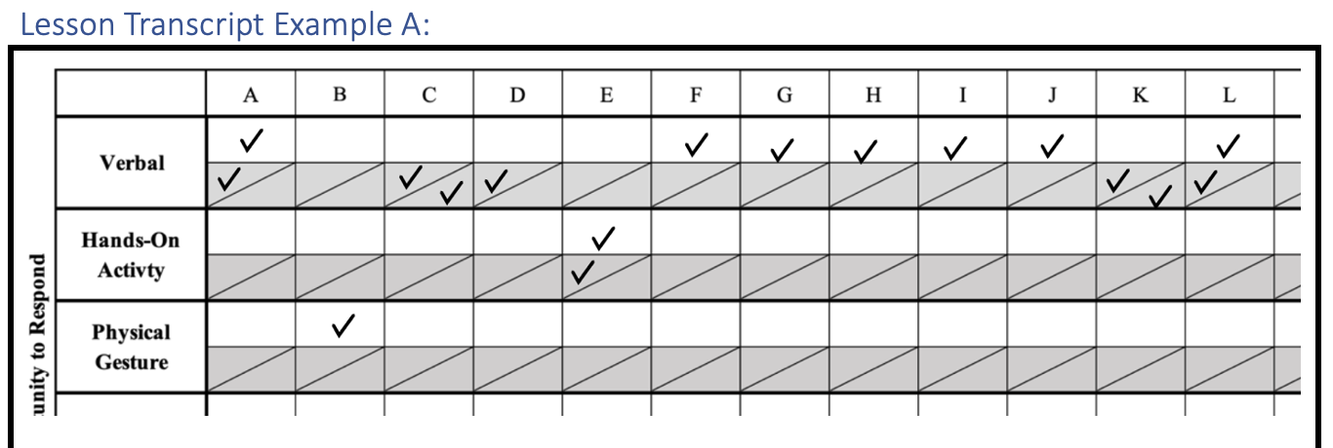
LESSON TRANSCRIPT EXAMPLE A
Teacher: “Good morning, class! Please take out your materials.”
[Students take out their materials.]
Teacher: “Let's review what we learned last time. First question for everyone: What's the Earth's primary source of energy?”
All Students (including Target Student): “The Sun!” (Verbal: All students, including Target Student)
Teacher: “Great! Now, thumbs up if you agree: Does the Earth orbit around the Sun?”
[Students, except Timmy (Target Student), raise their thumbs.] (Physical Gesture: Non-target student)
Teacher: “Good. Timmy, what's the process of water changing from a liquid to a gas?”
Timmy: “Evaporation?” (Verbal: Target Student)
Teacher: “Not quite, Timmy. It's called condensation. But don't worry, you'll get it. Here's another one for you, what's the process when water changes from a gas back into a liquid?” (Teacher feedback)
Timmy: “That's condensation!” (Verbal: Target Student)
Teacher: Excellent, Timmy! You got it! Keep it up.

Slide 69
LESSON TRANSCRIPT EXAMPLE A
[The class breaks into groups for an experiment and all including Timmy engage in an experiment.] (Hands-On Activity: All students, including Target Student)
[After some time, the teacher asks two non-target students questions about the experiment.] (Verbal: Non-target student X 2)
Teacher: “Timmy, let's join your group now and work together.”
[Timmy joins his group, and they continue the experiment.]
[After the experiment...]
Teacher: “Alright, class, let's come back to our seats. What did we learn about how temperature affects the rate of a chemical reaction?”
[Teacher calls on three non-target students and each respond.] (Verbal: Non-target student X 3)
Teacher: “Excellent! Now, Timmy, what's the name of the process when a solid turns into a liquid?”
Timmy: “Melting!” (Verbal: Target Student)
Teacher: “Great job, Timmy! Melting is when a solid turns into a liquid. And, class, what's the name of the process when a gas turns into a liquid?” (Teacher feedback)
[All students respond in unison including Timmy.] (Verbal: All students, including Target Student)

Slide 70
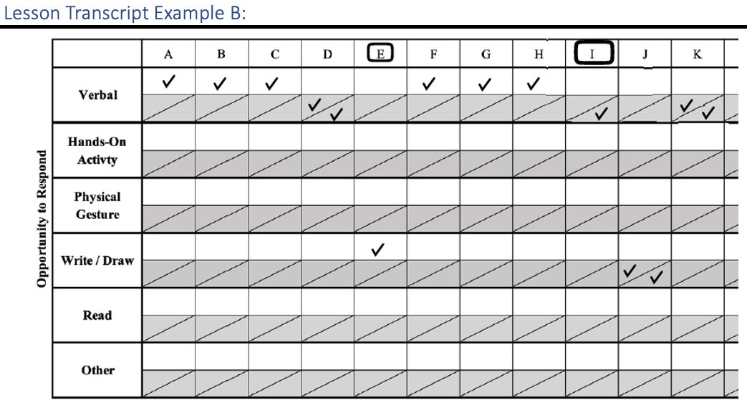
LESSON TRANSCRIPT EXAMPLE B
Teacher: “Good morning, class! Today, we're going to learn about the water cycle by reading this book together.”
[The teacher starts reading the book, pausing to ask questions.]
Teacher: “Okay, class, what's the first step in the water cycle?”
Non-target student: “Evaporation!” (Verbal: Non-target student)
Teacher: “That's right, Sarah! Now, who can tell me what happens next in the water cycle?”
[Two non-target students respond with the wrong answers.] (Verbal: Non-target student X 2)
Teacher: “Great effort, but let's think about it a bit more.”
Timmy: “Um... condensation?” (Verbal: Target student)
Teacher: “Almost there, Timmy. Condensation comes later. Let's keep listening.” (Teacher feedback)
[Continues reading, and Timmy asks to go to the bathroom.] Teacher: “Timmy, alright, but be quick.”

Slide 71
LESSON TRANSCRIPT EXAMPLE B
[Timmy leaves, and the teacher continues reading.]
[Note time and circle column]
Teacher: “Now, let's transition to writing in our notebooks about what we've learned from the book.”
[Students start writing as the teacher asks questions.] (Write / Draw: Non-target student)
Teacher: What is one stage of the water cycle you are writing about?
[Three non-target students respond, each with a different stage of the water cycle.] (Verbal: Non-target student X 3)
Teacher: “Timmy, welcome back! Please grab your notebook and write about the water cycle.”
Timmy: “Okay, what do I write?”
Teacher: “Good question, Timmy. Start by writing about evaporation when water turns into vapor due to heat.” (Teacher feedback)
[Timmy starts writing with the teacher's guidance.] (Write / Draw: Target Student)
Teacher: Nice job with your drawing of the water cycle, Timmy. (Teacher feedback)

Slide 72
LESSON TRANSCRIPT EXAMPLE B
Teacher to class: “Now, let's watch a science video on YouTube about the water cycle.
[After the video...]
Teacher: “Alright, class, what did we learn about the water cycle from the video?”
Timmy: “I learned that the water cycle is like a big circle, where water goes up into the sky, comes down as rain, and then goes up again.” (Verbal: Target student)
Teacher: “Excellent, Timmy! You're absolutely right. The water cycle is indeed a continuous process. Great job, everyone!” (Teacher feedback)

Slide 73
LESSON TRANSCRIPT EXAMPLE C
Teacher: “Alright class, let's get started with today's science lesson. Please take out your science journals and a pencil.”
[Students rustle around as they gather their materials.]
Teacher: “Now, who can tell me something they know about water? Raise your hand.”
[Many hands shoot up.]
Teacher: “Yes, Sarah?”
Sarah (non-target student): “Water is H2O!”
Teacher: “Exactly, water is made up of two hydrogen atoms and one oxygen atom. Now, raise your hand if you've ever noticed that water beads up on some surfaces but not on others.”
[Nearly all students raise their hands, including Timmy (Target Student).]
Teacher: “Very good. That's due to a property of water called...?”
Timmy: [Blurting out without raising his hand] “Magic?”
Teacher: “Not quite, Timmy. Remember to raise your hand before answering. The property is called ‘cohesion’. It means water molecules stick together. But, since we're on you, Timmy, can you tell me why ice floats in water?”

Slide 74
LESSON TRANSCRIPT EXAMPLE C
Timmy: “Because... it's lighter?”
Teacher: “Not quite, Timmy. It's a common misconception. Ice floats because it's less dense than water. As water freezes, it expands. But that's a great try! Always remember, mistakes are how we learn.”
Teacher: “Now, for today's experiment, we're going to look at how temperature affects the solubility of a solid in water. Everyone put on your safety goggles.”
[The students excitedly put on their goggles.]
Teacher: “In front of you, you have a beaker of water, a thermometer, some salt, and a stirring rod. First, I want you to measure the temperature of the water and record it in your journals.”
[All students start the experiment. The teacher walks around the classroom, observing and guiding.]
Teacher: [To a group of students not including Timmy] “What do you predict will happen when we add salt to cold water versus warm water?”
Non-target student 1: “I think it will dissolve faster in warm water!”
Teacher: “That's a good hypothesis. Why do you think so?”
Non-target student 2: “Because heat makes things move faster, maybe?”
Teacher: “Very insightful! Heat does increase the kinetic energy of molecules, which can help solids dissolve faster.”

Slide 75
LESSON TRANSCRIPT EXAMPLE C
Teacher: “Alright class, let's get started with today's science lesson. Please take out your science journals and a pencil.”
[Students rustle around as they gather their materials.]
Teacher: “Now, who can tell me something they know about water? Raise your hand.”
[Many hands shoot up.]
Teacher: “Yes, Sarah?”
Sarah (non-target student): “Water is H2O!” (Verbal: Non-target student)
Teacher: “Exactly, water is made up of two hydrogen atoms and one oxygen atom. Now, raise your hand if you've ever noticed that water beads up on some surfaces but not on others.”
[Nearly all students raise their hands, including Timmy (Target Student).] (Physical Gesture: All students, including Target Student)
Teacher: “Very good. That's due to a property of water called...?”
Timmy: [Blurting out without raising his hand] “Magic?” (Verbal: Target Student)
Teacher: “Not quite, Timmy. Remember to raise your hand before answering. The property is called ‘cohesion’. It means water molecules stick together. But, since we're on you, Timmy, can you tell me why ice floats in water?” (Teacher Feedback)

Slide 76
LESSON TRANSCRIPT EXAMPLE C
Timmy: “Because... it's lighter?” (Verbal: Target Student)
Teacher: “Not quite, Timmy. It's a common misconception. Ice floats because it's less dense than water. As water freezes, it expands. But that's a great try! Always remember, mistakes are how we learn.” (Teacher feedback)
Teacher: “Now, for today's experiment, we're going to look at how temperature affects the solubility of a solid in water. Everyone put on your safety goggles.”
[The students excitedly put on their goggles.]
Teacher: “In front of you, you have a beaker of water, a thermometer, some salt, and a stirring rod. First, I want you to measure the temperature of the water and record it in your journals.”
[All students start the experiment. The teacher walks around the classroom, observing and guiding.] (Hands-On Activity: All students, including Target Student)
Teacher: [To a group of students not including Timmy] “What do you predict will happen when we add salt to cold water versus warm water?”
Non-target student 1: “I think it will dissolve faster in warm water!” (Verbal: Non-target student)
Teacher: “That's a good hypothesis. Why do you think so?”
Non-target student 2: “Because heat makes things move faster, maybe?” (Verbal: Non-target student)
Teacher: “Very insightful! Heat does increase the kinetic energy of molecules, which can help solids dissolve faster.”

Slide 77
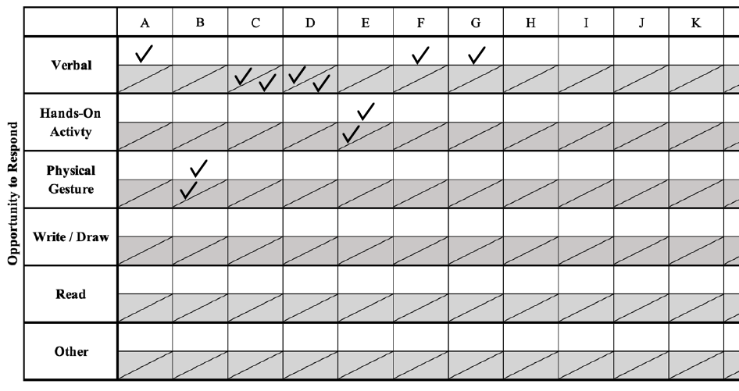
LESSON TRANSCRIPT EXAMPLE C

Slide 78
OBSERVATION TRAINING
CROWDSOURCE: SCIENCE
CODING PRACTICE:
VIDEOS

Slide 79
LESSON VIDEO #1
(0:00-2:50)
Target Student = “Teason” (wearing a green shirt and raising his hand in the still image)

Slide 80
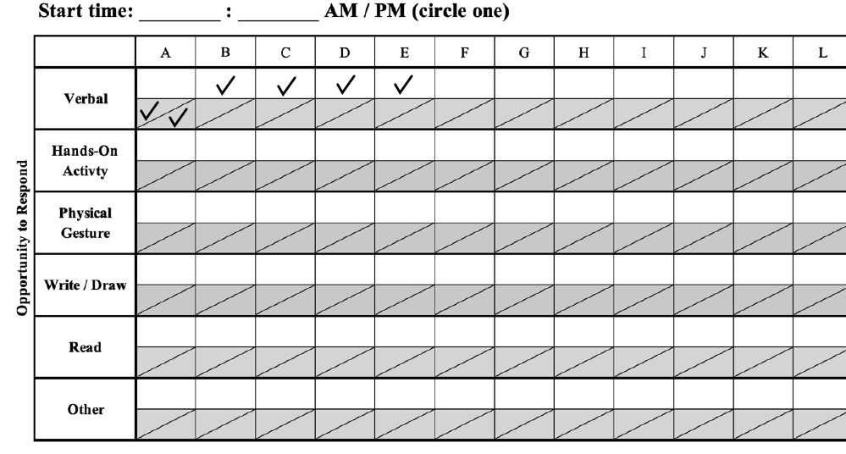
LESSON VIDEO #1
Teacher: “…observations again with more time. You probably could have done this all day with all different kinds of materials and different shapes of ice. You can do more of this if you want or you can do it on your own at home. Not today, but the purpose, as I told you before we started, of today's lesson was to make a plan but then to synthesize the information from your observations and the article to come up with an explanation, right? So, we're trying to explain why this is happening.”
Teacher: “So, who wants to share what they noticed in their observations? I talked to all of you, but let's share out in the group. Teason (Target Student), what did you notice?”
Teason: “Ice and water.” (Verbal: Target student)
Teacher: “Okay, what effect does salt have on ice? So, Teason’s observation was completely valid, it was something he saw, but let's relate our observations to the focus questions. What did you notice when observing the ice interacting with the salt and vise versa? (Teacher feedback)

Slide 81
LESSON VIDEO #1
Non-target student 1: “When I put like the smaller salt, well it kind of like went in the ice and it started melting.” (Verbal: Non-target student)
Teacher: “Okay so the fine salt…, you noticed the finer salt melted the ice and goes into the ice. What are the other observations?”
Non-target student 2: “I noticed that the ice cream salt, it was melting the ice on top of it and also it was forming craters in it. ” (Verbal: Non-target student)
Teacher: “Okay so it melted the ice on top of it. What do you mean? Say more.”
Non-target student 2: “He said the ice went inside it and melted, well the ice cream one stayed on top and melted it.” (Verbal: Non-target student)
Teacher: “So you’re saying the fine salt kind of went into the ice, whereas the rock salt stayed on top and the ice sort of melted right under it and formed a crater. So, I’m kind of visualizing like the fine salt doing this to the ice and the coarse salt doing this. Is that what you saw?”
Non-target student 2: “Yeah.” (Verbal: Non-target student)
Teacher: “Okay so I’m not going to write all that because it is a lot of information, but it is very interesting.”

